Slide 1
MScIT Semester 2 Big Data Analytics Practical 11: Hadoop Installation Mumbai University By Pushpa Mahapatro

Slide 2
Install, configure and run Hadoop and HDFS and explore HDFS on Windows
Steps to Install Hadoop
1. Install Java JDK 1.8
2. Download Hadoop and extract and place under C drive
3. Set Path in Environment Variables
4. Config files under Hadoop directory
5. Create folder datanode and namenode under data directory
6. Edit HDFS and YARN files
7. Set Java Home environment in Hadoop environment
8. Setup Complete. Test by executing start-all.cmd

Slide 3

There are two ways to install Hadoop, i.e.
9. Single node
10. Multi node
Here, we use multi node cluster.
1. Install Java
11. – Java JDK Link to download
https://www.oracle.com/java/technologies/javase-jdk8-downloads.html
12. – extract and install Java in C:\Java
13. – open cmd and type -> javac -version

Slide 4
2. Download Hadoop
https://www.apache.org/dyn/closer.cgi/hadoop/common/hadoop-3.3.0/hadoop-3.3.0.tar.gz
• right click .rar.gz file -> show more options -> 7-zip->and extract to C:\Hadoop-3.3.0\

Slide 5
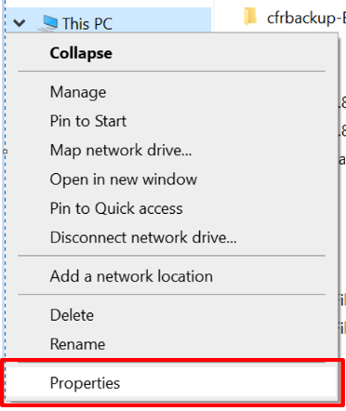
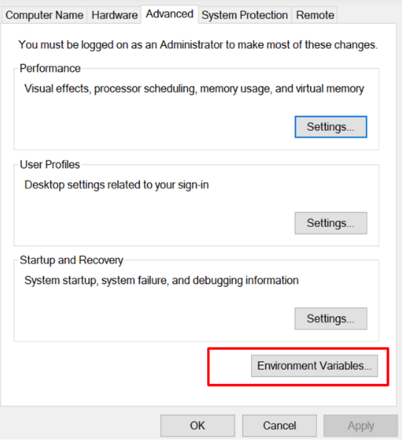
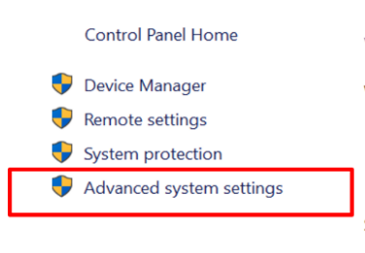
3. Set the path JAVA_HOME Environment variable
4. Set the path HADOOP_HOME Environment variable

Slide 6
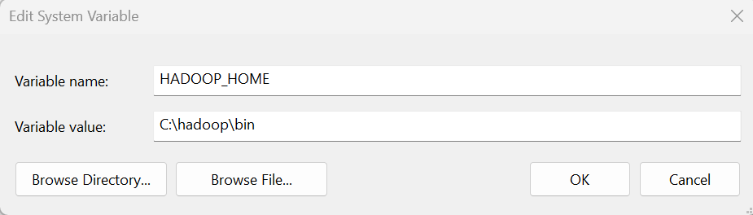
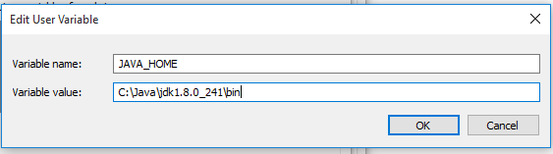
Click on New to both user variables and system variables.

Slide 7
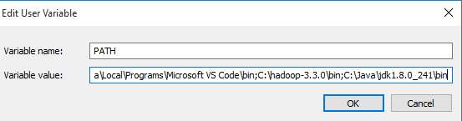
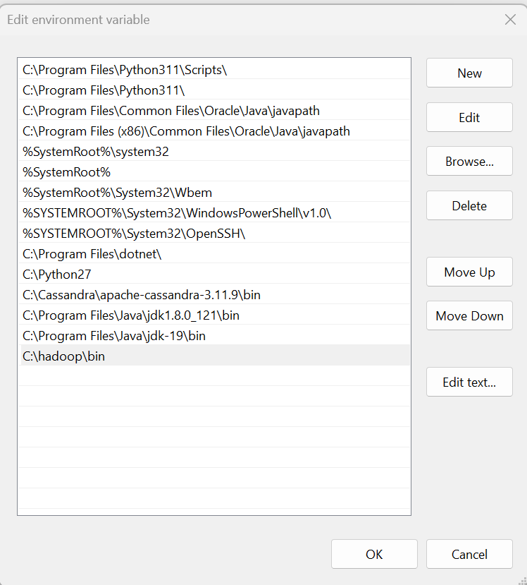
Click on user variable -> path -> edit-> add path for Hadoop and java upto ‘bin’

Slide 8
5. Configurations
Edit file C:\hadoop\etc\hadoop\core-site.xml,
paste the xml code in folder and save
<configuration>
<property>
<name>fs.defaultFS</name>
<value>hdfs://localhost:9000</value>
</property>
</configuration>

Slide 9
Rename “mapred-site.xml.template” to “mapred-site.xml” and edit this file C:/hadoop/etc/hadoop/mapred-site.xml, paste xml code and save this file
<configuration>
<property>
<name>mapreduce.framework.name</name>
<value>yarn</value>
</property>
</configuration>

Slide 10
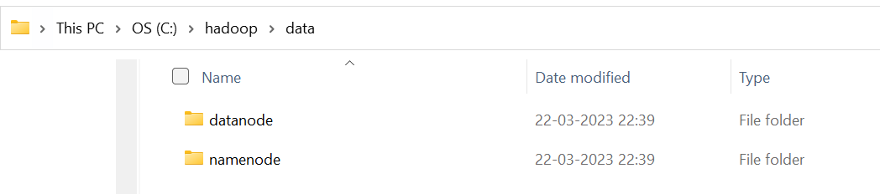
Create folder “data” under “C:\Hadoop-3.3.0”
Create folder “datanode” under “C:\Hadoop-3.3.0\data”
Create folder “namenode” under “C:\Hadoop-3.3.0\data”

Slide 11
Edit file C:\Hadoop-3.3.0/etc/hadoop/hdfs-site.xml,
paste xml code and save this file.
<configuration>
<property>
<name>dfs.replication</name>
<value>1</value>
</property>

Slide 12
<property>
<name>dfs.namenode.name.dir</name>
<value>/hadoop-3.3.0/data/namenode</value>
</property>
<property>
<name>dfs.datanode.data.dir</name>
<value>/hadoop-3.3.0/data/datanode</value>
</property>
</configuration>

Slide 13
Edit file C:/Hadoop-3.3.0/etc/hadoop/yarn-site.xml,
paste xml code and save this file.
<configuration>
<property>
<name>yarn.nodemanager.aux-services</name>
<value>mapreduce_shuffle</value>
</property>
<property>
<name>yarn.nodemanager.auxservices.mapreduce.shuffle.class</name>
<value>org.apache.hadoop.mapred.ShuffleHandler</value>
</property>
<property>
<name>yarn.resourcemanager.address</name>
<value>127.0.0.1:8032</value>
</property>
<property>
<name>yarn.resourcemanager.scheduler.address</name>
<value>127.0.0.1:8030</value>
</property>
<property>
<name>yarn.resourcemanager.resource-tracker.address</name>
<value>127.0.0.1:8031</value>
</property>
</configuration>

Slide 14
6. Edit file C:/Hadoop-3.3.0/etc/hadoop/hadoop-env.cmd
Find “JAVA_HOME=%JAVA_HOME%” and replace it as
set JAVA_HOME="C:\java\jdk1.8.0_121"

Slide 15
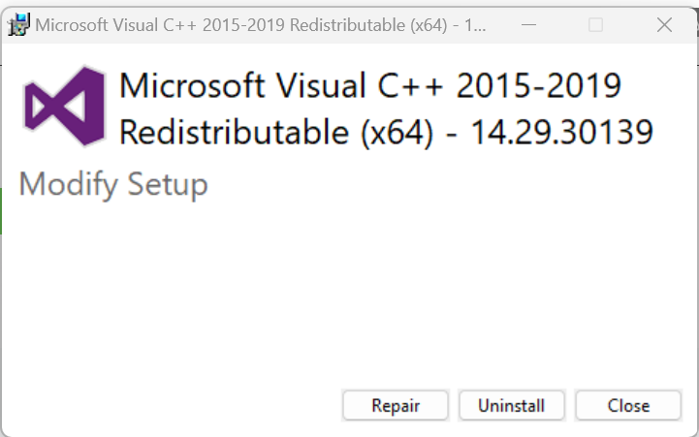
7. Download “redistributable” package
Download and run VC_redist.x64.exe
This is a “redistributable” package of the Visual C runtime code for 64-bit applications, from Microsoft. It contains certain shared code that every application written with Visual C expects to have available on the Windows computer it runs on.

Slide 16
8. Hadoop Configurations
Download bin folder from
https://github.com/s911415/apache-hadoop-3.1.0-winutils
– Copy the bin folder to c:\hadoop-3.3.0. Replace the existing bin folder.
9. copy "hadoop-yarn-server-timelineservice-3.0.3.jar" from ~\hadoop-3.0.3\share\hadoop\yarn\timelineservice to ~\hadoop-3.0.3\share\hadoop\yarn folder.

Slide 17
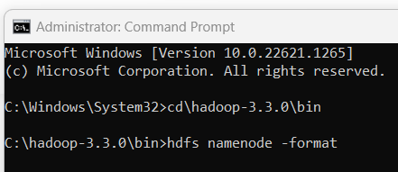
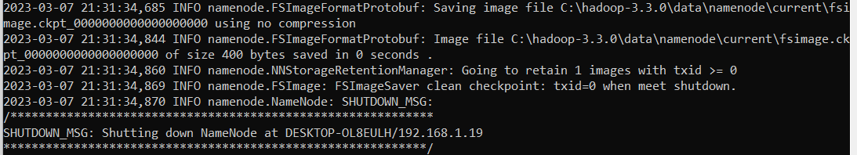
Format the NameNode
– Open cmd ‘Run as Administrator’ and type command “hdfs namenode –format”

Slide 18
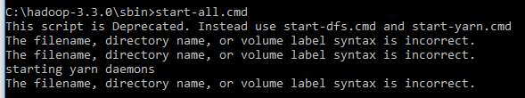
. Testing
– Open cmd ‘Run as Administrator’ and change directory to C:\Hadoop-3.3.0\sbin
– type start-all.cmd
OR
- type start-dfs.cmd
– type start-yarn.cmd

Slide 19
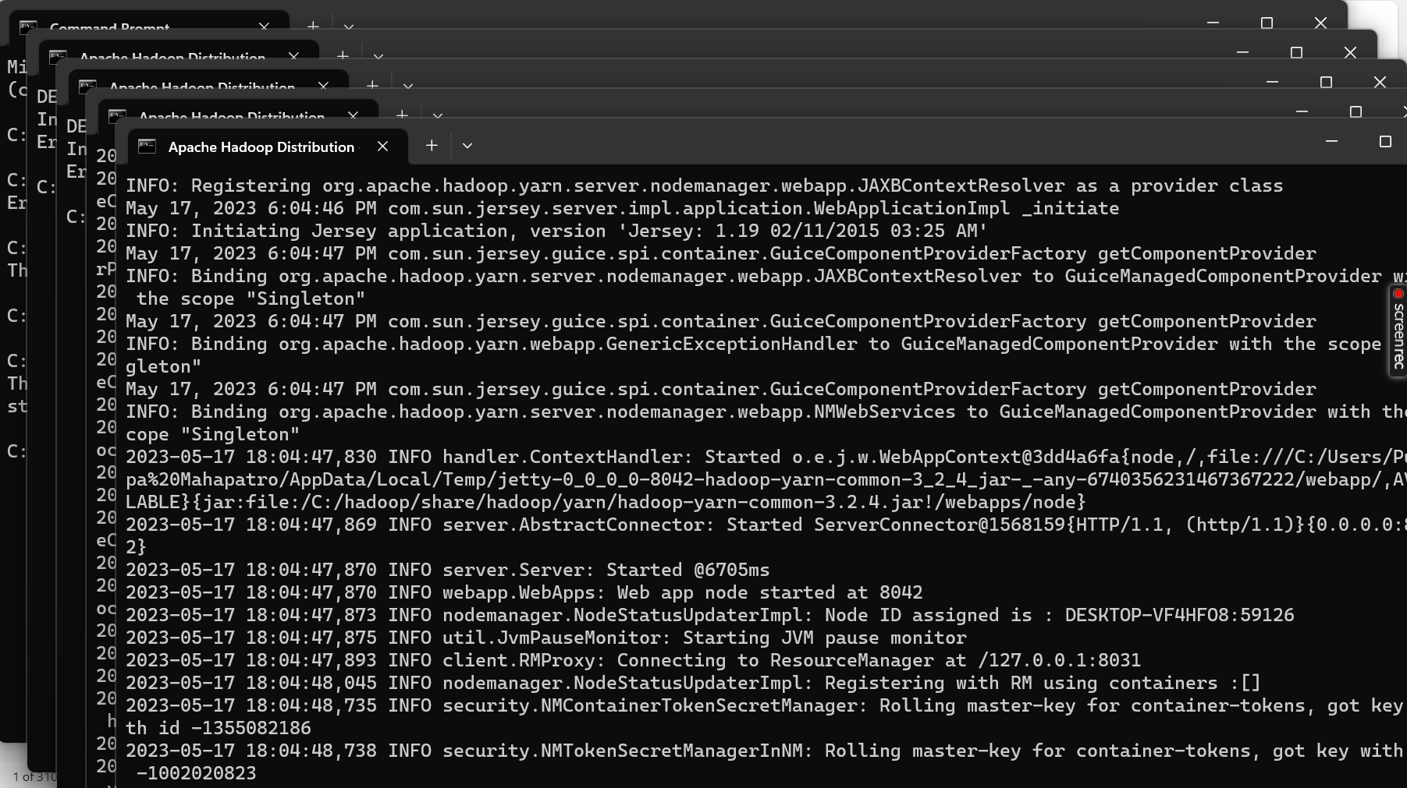
Type start-all.cmd

Slide 20
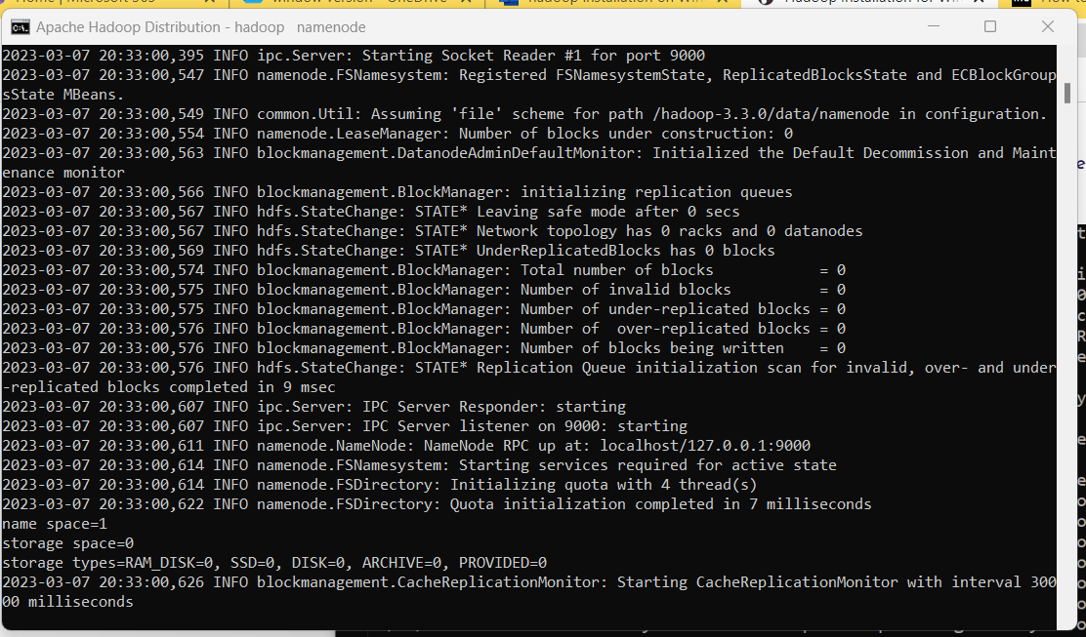
You will get 4 more running threads for Datanode, namenode, resouce manager and node managerYou will get 4 more running threads for Datanode, namenode, resouce manager and node manager

Slide 21
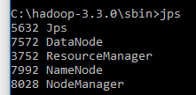
Type JPS command to start-all.cmd command prompt, you will get following output.

Slide 22
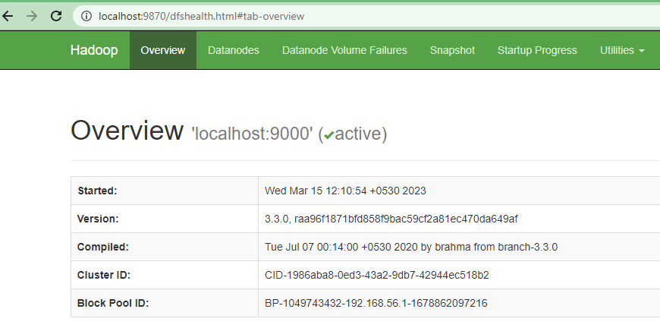
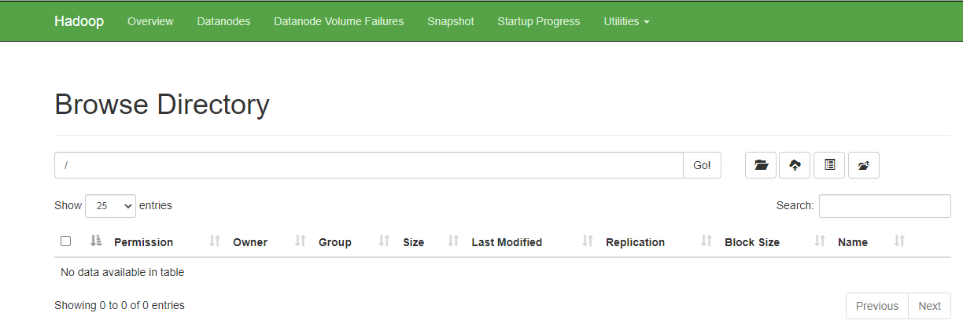
Run http://localhost:9870/ from any browser

Slide 23

Thank you…

